Slide 1
Bollinger Band & SMA/EMA:
Strategies for Cryptocurrency Trading
Group 7
Mengyuan Li, Sasha Cui, Hongyu Mao Jessica Chen, Rylie Gao
Notes:
Good morning everyone, we are group 7. Our project provides a few insights for Cryptocurrency Trading. We utilized Bollinger Band & Simple Moving Average/Exponential Moving Average strategies.

Slide 2
Background
Revolutionize the way the world views traditional financial institutions
The price of bitcoin has reached the pinnacle on Dec 2017
Because of the price volatility, we are interested in the trading strategies of cryptocurrency
Notes:
What is noteworthy is that the price of bitcoin has reached the highest point on December 2017. Because of the high price volatility, this mysterious currency entered the public view.

Slide 3
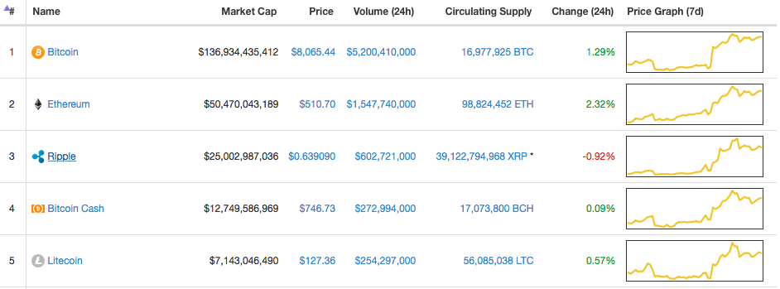
Cryptocurrency
From: https://coinmarketcap.com
Notes:
Reference:https://coinmarketcap.com
Among hundreds of cryptocurrencies, we chose to analyze Bitcoin because it has the largest market cap.

Slide 4
Bitcoin Overview
A digital currency created in 2009
Offers the promise of lower transaction fees than traditional online mechanisms
Operated by a decentralized authority
Notes:
Bitcoin is a digital currency created in 2009. Bitcoin offers the promise of lower transaction fees than traditional online payment and is operated by a decentralized authority, unlike government-issued currencies.
Now I will pass to Sasha for the strategy of Bollinger Band.

Slide 5
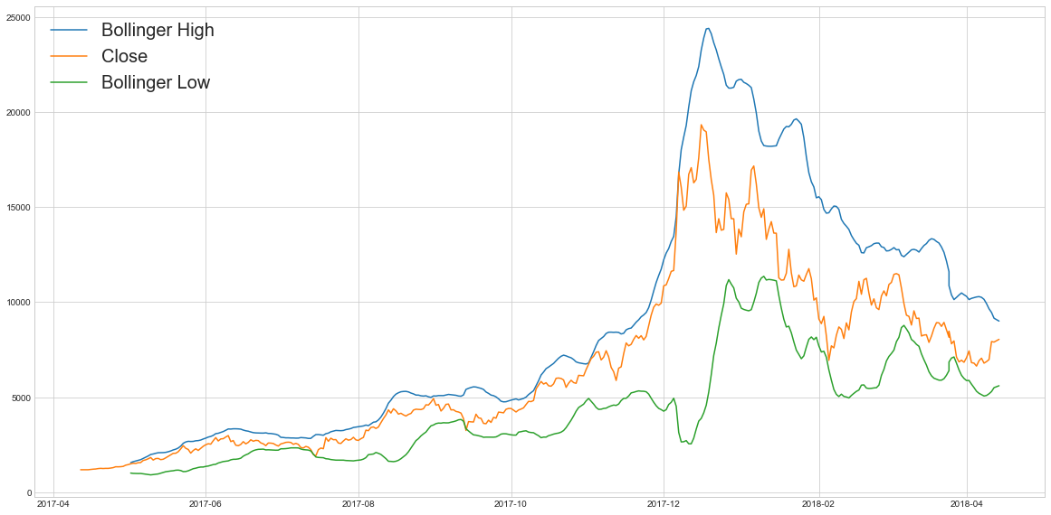
Bollinger Band
Upper band: N-Day Moving Average + Kσ
Close: Daily Closing Price of Bitcoin
Lower band: N-Day Moving Average - Kσ
Notes:
1. a financial volatility indicator that is used to characterize the trading band of securities
2. consist of an N-period moving average, an upper band (MA + Kσ), and a lower band (MA − Kσ).
3. However, here, we didn’t plot the N-day MA which is equally spaced in between the upper and lower band,
4. Instead, we plotted daily closing price from April 2017 to April 2018

Slide 6
Assumptions
1. Unlimited Capital
2. All Four Types of Trade Orders : Buy, Sell, Short Sell, Buy to Cover
3. Daily Strategy Execution and Liquidation
Day N | Buy/Buy to Cover | Sell/Short Sell
Day N+1 | Sell/Short Sell | Buy/Buy to Cover
Notes:
The strategy is executed on daily basis. Same for the liquidation.
3.Before the market close, we will buy or sell 1 unit of bitcoin and reverse the position before the market close on the next day.

Slide 7
How to apply this strategy?
Enter Short
position
Enter
Long
Position
Notes:
3. buy when price touches lower Bollinger band and sell when price hits high Bollinger band.
Oversold==Underpriced----->Long Position
Overbought==Overpriced------->Short Position =

Slide 8
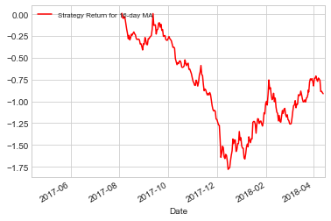
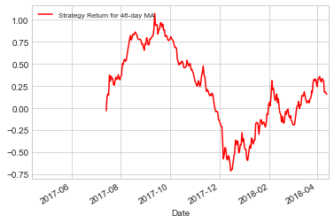
The Performance of Bollinger Band (K=3)
Cumulative Sum of 17-Day MA Strategy Returns Cumulative Sum of 46-Day MA Strategy Returns
Notes:
From our experiments, we found out that when K is fixed to 3, we can get the largest interval for satisfying N.
The resulting cumulative summation curve of returns will fluctuates around or always below x-axis, indicating capital losses.

Slide 9
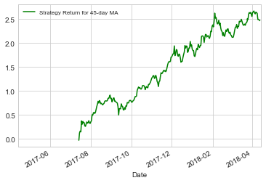
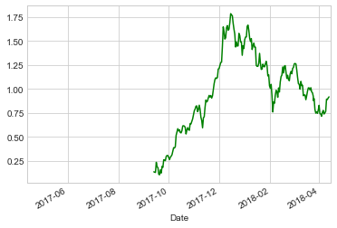
The Performance of Bollinger Band (K=3)
Cumulative Sum of 18-Day MA Strategy Returns Cumulative Sum of 45-Day MA Strategy Returns
Notes:
When N is between 18 and 45, we can obtain continuous positive curve, indicating capital gains.
And now, I will pass the time to Rylie for the summary and further analysis of the strategy

Slide 10
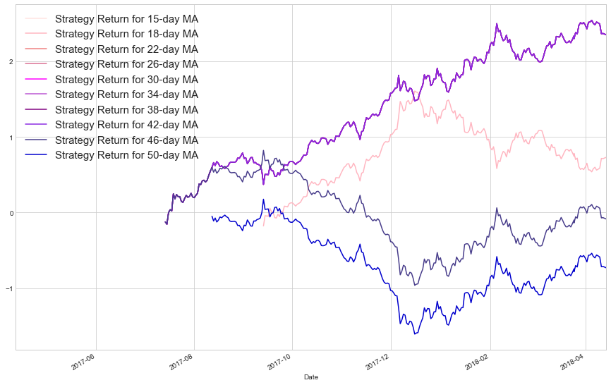
The Performance of Bollinger Band (K=3)
Notes:
Too see it more clearly, we plotted characterized n-day MA strategy returns on the same graph ranging from 15 to 50. The optimized result ranges from pink to purple which corresponds to the interval 18-45.

Slide 11
Analysis of the result
1. Using N between 18 to 45 will give us a generally positive return, enabling capital gains.
2. Only K=3 leads to continuous positive cumulative returns within the [18,45]
3. The N-K combination needs adjustments across different time periods.
Notes:
3. Since the cryptocurrencies highly volatile nature.

Slide 12
Shortcomings
Bollinger Bands are derived from a simple moving average, so they will always react to price moves but will not forecast them.
There is no way to know when the selling pressure or buying interest will come to an end.
Standard settings will not work for all traders. Active traders vs. Long-term traders

Slide 13
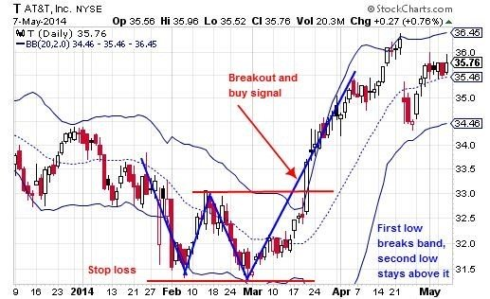
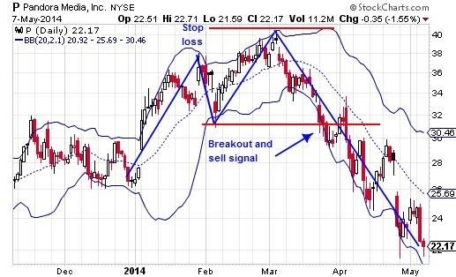
Further Improvements
1. Combine with M and W price patterns aids in spotting major reversal signals.
2. Predict and take advantage of the breakout: E.g. Tightening of Bollinger Bands.

Slide 14
SMA/EMA
SMA: Simple Moving Average
An average of the closing prices over the last n days of trading
Tracks the current trend of the market
EMA: Exponential Moving Average
Similar to SMA / A weighted SMA
Weights data points from closer to the present more heavily
Notes:
SMA stands for Simple Moving Average. This indicator tracks the current trend of the market; it is simply an average of the closing prices over the last n days of trading. Common values of n range from 5 to 50.
EMA stands for Exponential Moving average. This is a similar indicator. The only difference is that it weights data points from closer to the present more heavily. So this is essentially a weighted SMA.

Slide 15
SMA Crossover
Up-Cross signal
→ When the indicator based on a shorter time period crosses above the longer time period indicator
→ The short-term sentiment of the market is more positive
→ BUY signal
Notes:
The SMA crossover signal is based on the idea that when the indicator based on a shorter time period crosses above the longer time period indicator,
then this indicates that the short-term sentiment of the market is more positive than it has been in the long term.
Thus, this is a buy signal.

Slide 16
SMA Crossover
Down-Cross signal
→ When the short-term indicator crosses below
→ The sentiment at the moment is more negative
→ SELL signal
The same idea holds for EMA.
Notes:
Similarly, when the short-term indicator crosses below, the sentiment at the moment is more negative than it has been over the long term. And this represents a sell opportunity.
The same idea holds for EMA as well.

Slide 17
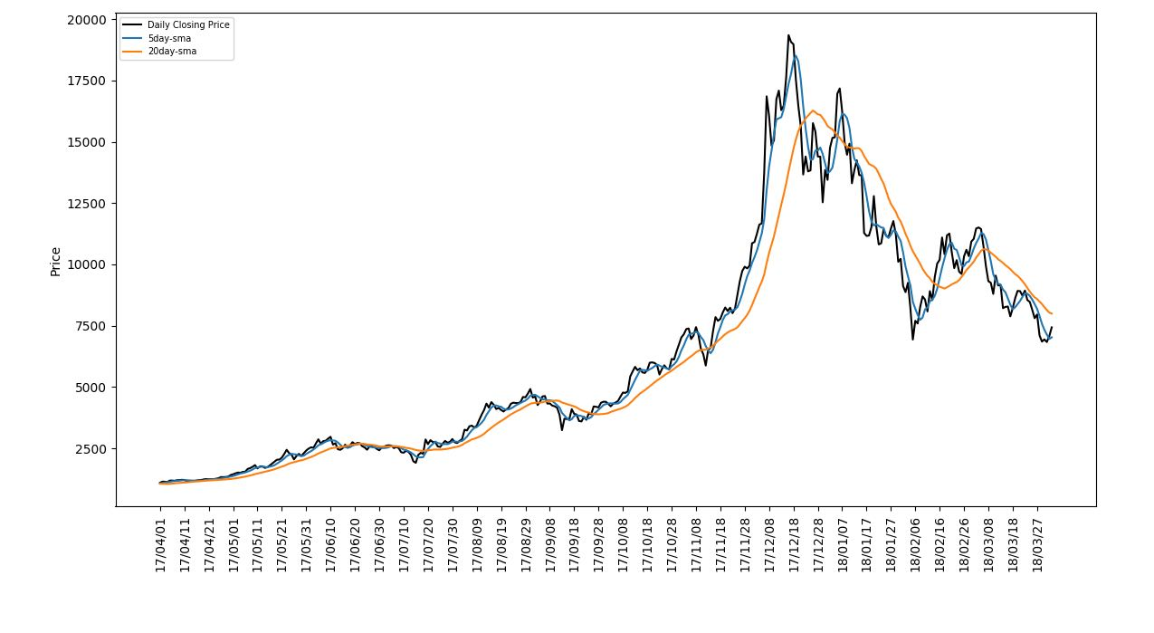
How to apply this strategy?
Notes:
长短线
Follow same assumption

Slide 18
Assumptions
1. Unlimited Capital
2. All Four Types of Trade Orders : Buy, Sell, Short Sell, Buy to Cover
3. Daily Strategy Execution and Liquidation
Day N | Buy/Buy to Cover | Sell/Short Sell
Day N+1 | Sell/Short Sell | Buy/Buy to Cover
Notes:
The strategy is executed on daily basis. Same for the liquidation.
3.Before the market close, we will buy or sell 1 unit of bitcoin and reverse the position before the market close on the next day.

Slide 19
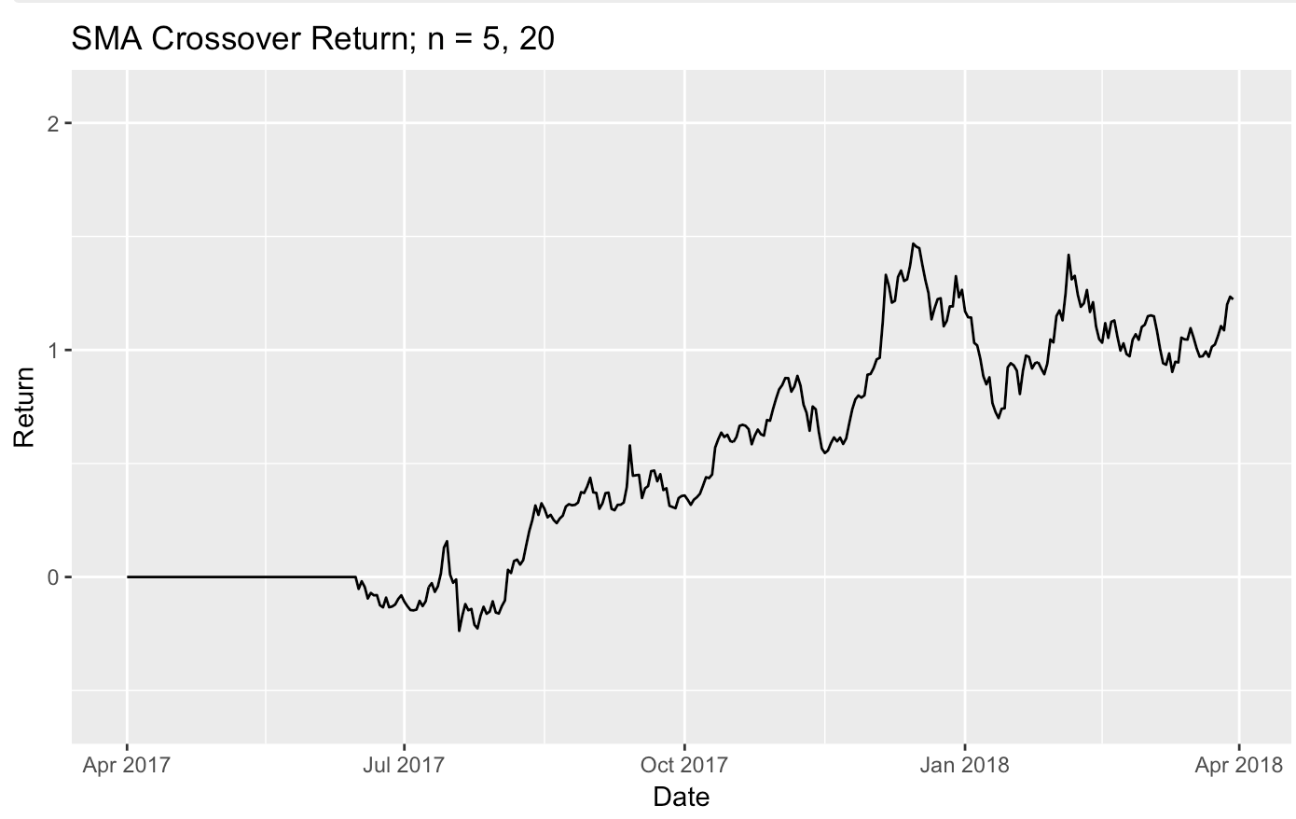
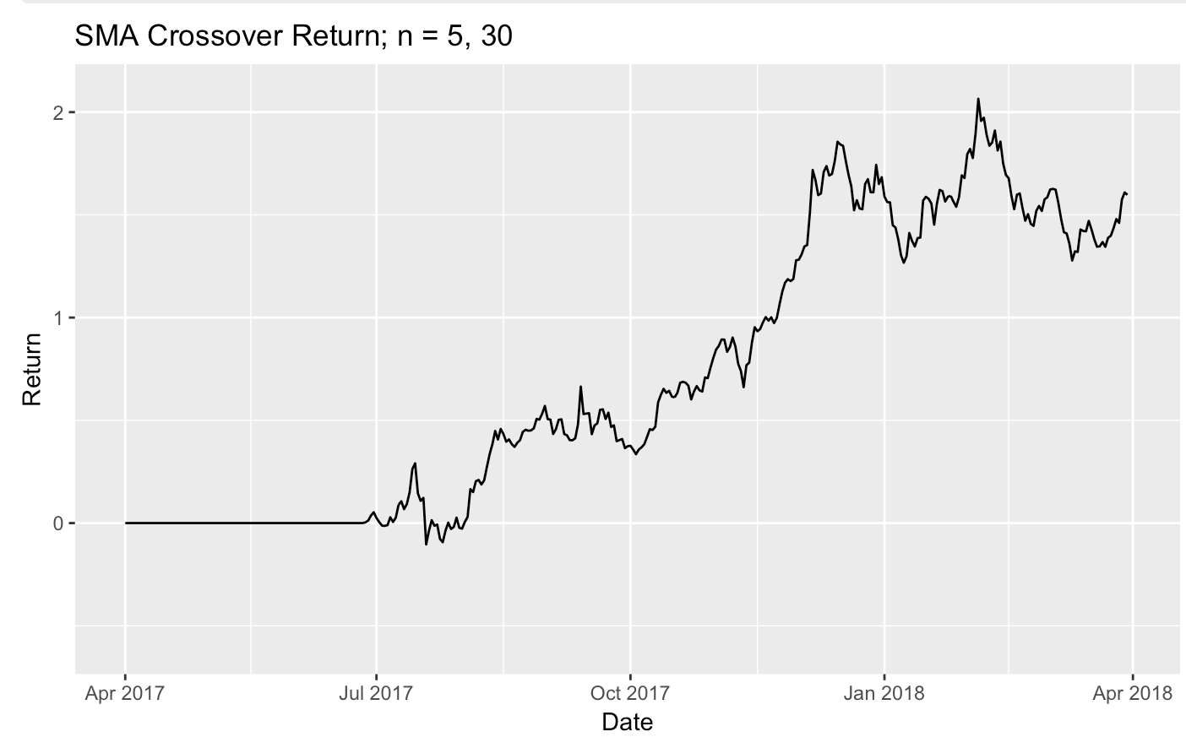
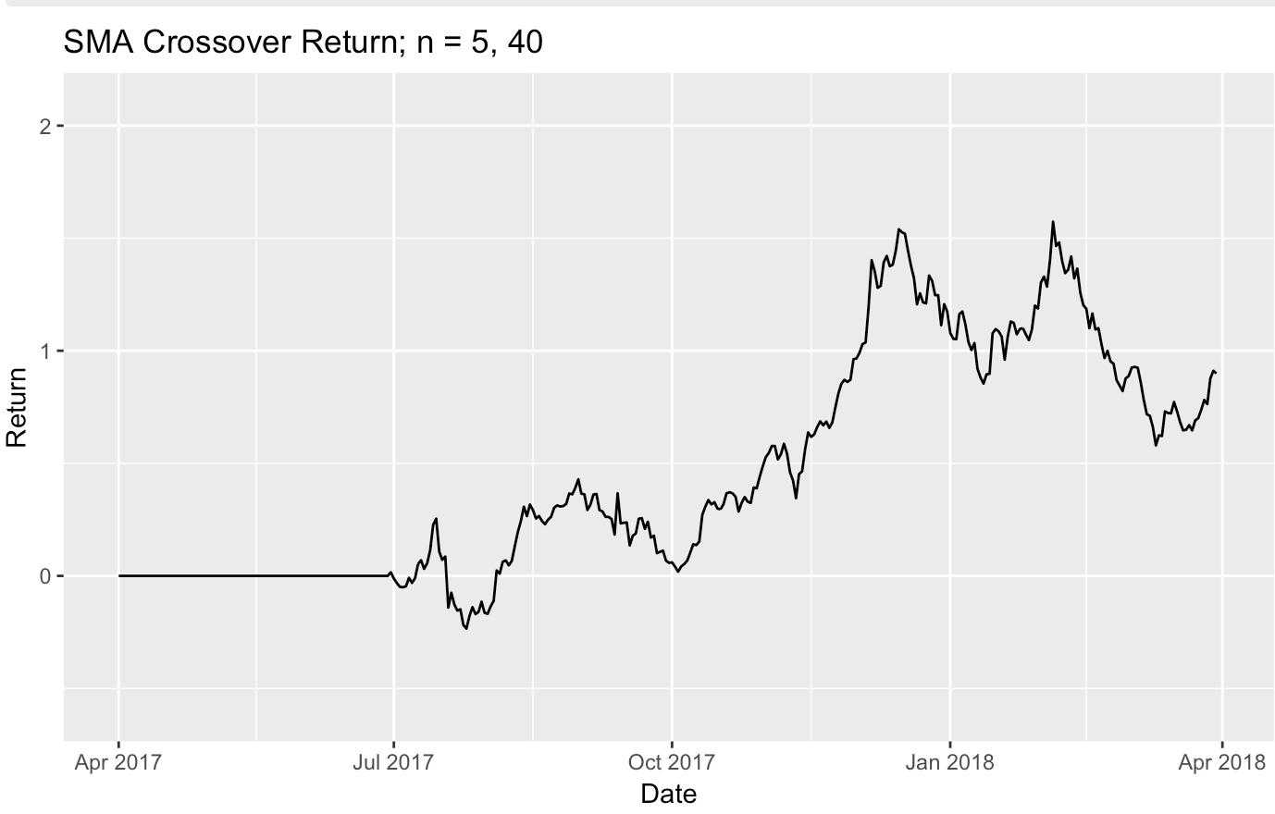
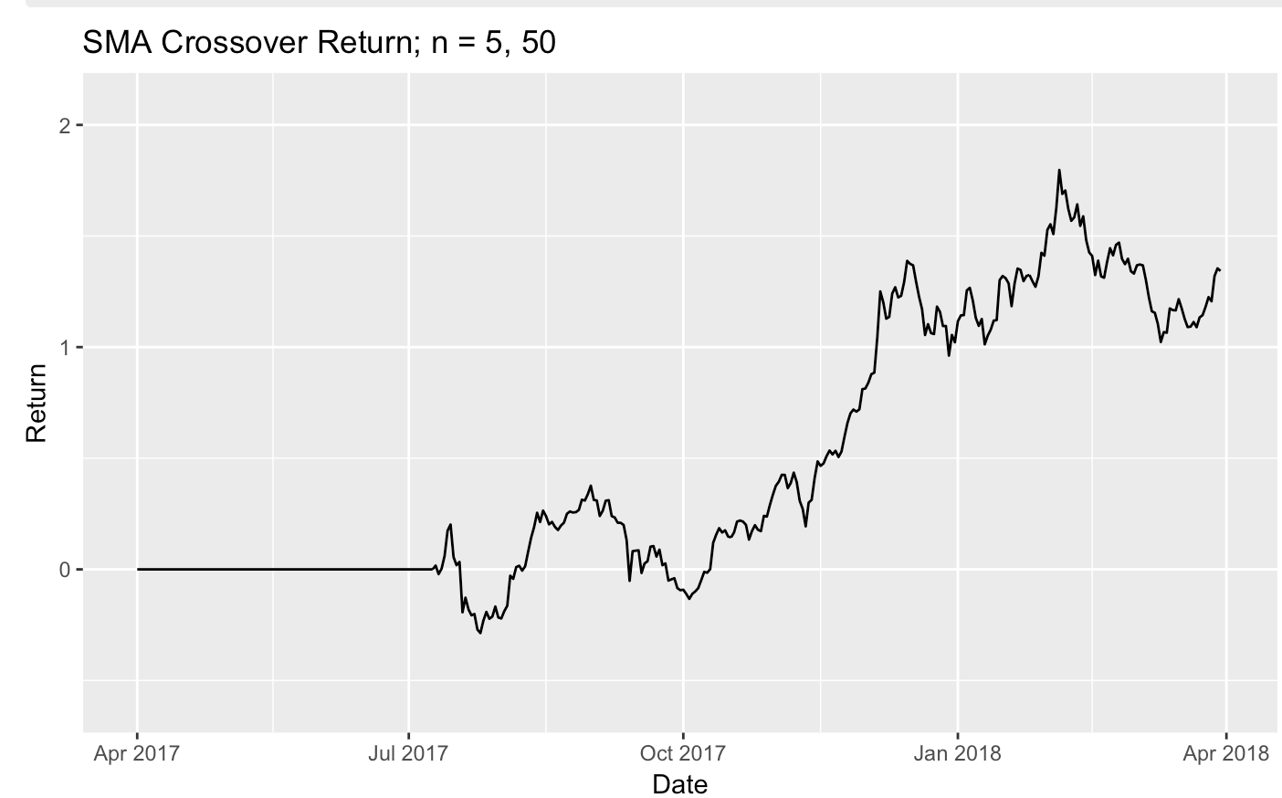
Analysis for the result
Bullet Points
(Mao)
Notes:
SMA: 30 best
Jul-Aug sometimes negative

Slide 20
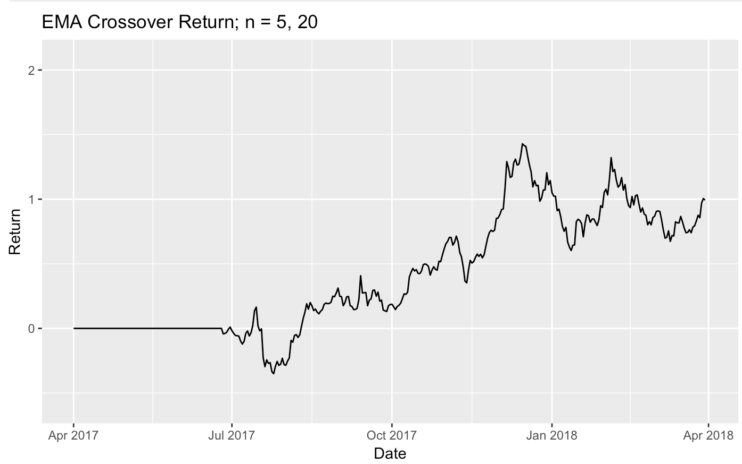
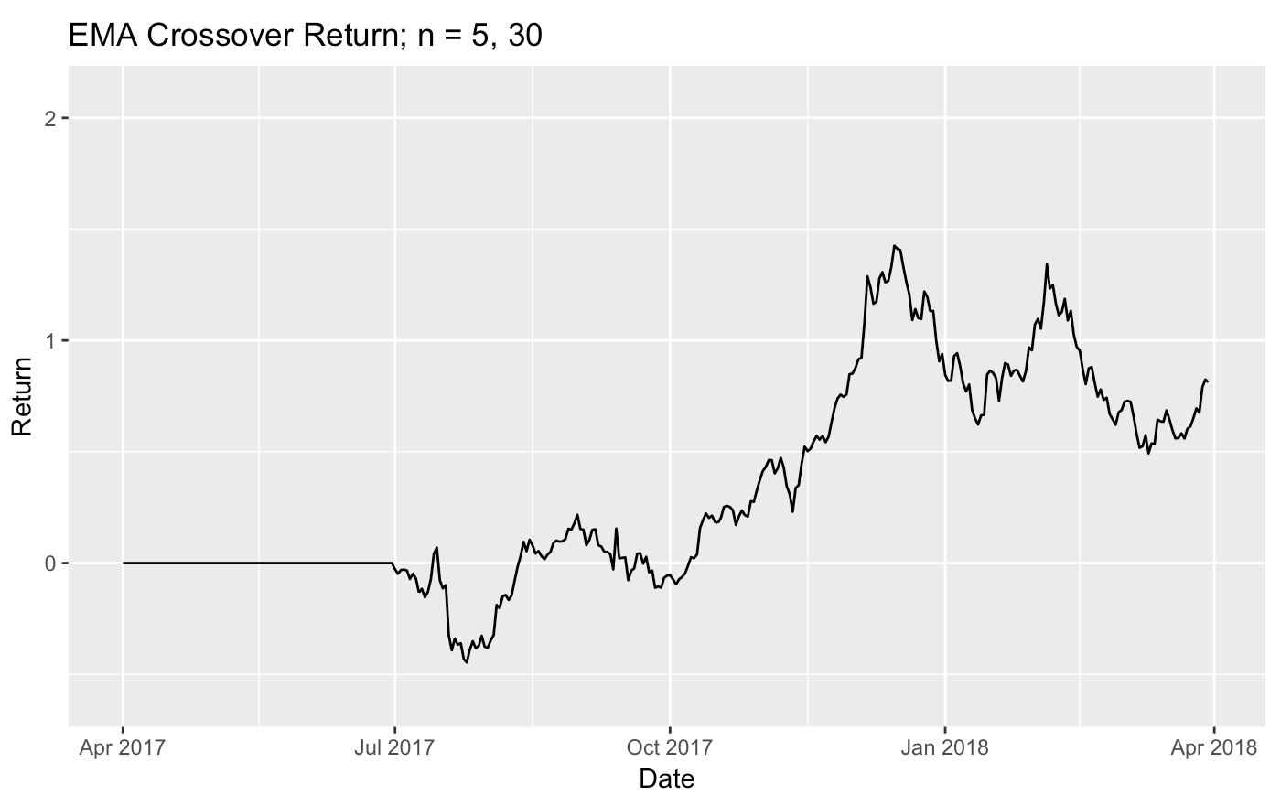
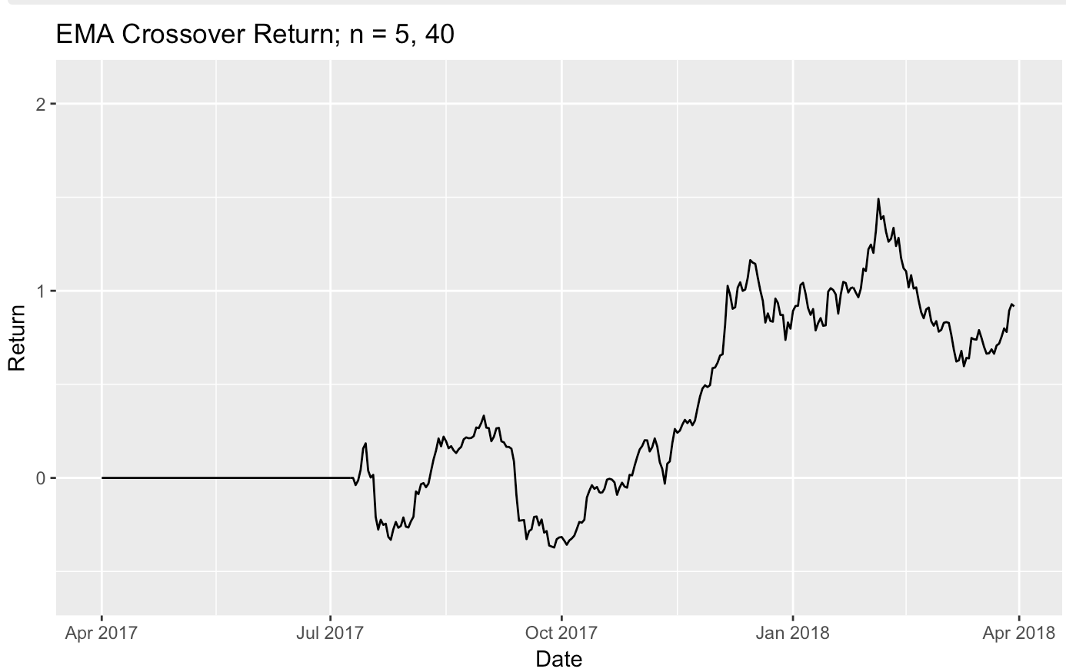
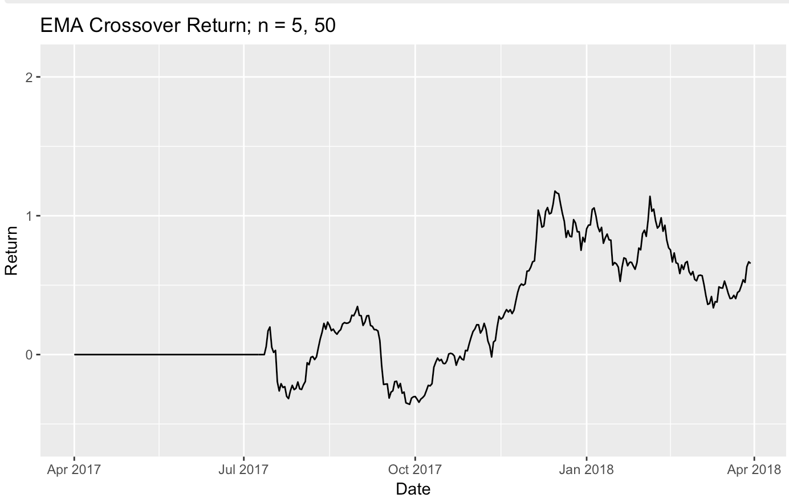
Shortcoming
(Mao)
Notes:
20 day: the best
EMA fluctuates more than SMA

Slide 21
Further Improvements
Combine SMA/EMA with other indicators, e.g. ADX
ADX: Average Directional Index
Used to measure the strength of the trend
If ADX implies strong signal, then use SMA/EMA
Notes:
The way we can improve this method is to combine it with other method, for example we can use the SMA/EMA together with the ADX indicator.
ADX is the Average Directional Index. It is an indicator used to measure the strength of the trend. And it can help traders choose the strongest trends.
So basically, we analyze the ADX indicator first. And if the signal is strong, we then use SMA/EMA to decide whether to buy or sell at this point.

Slide 22
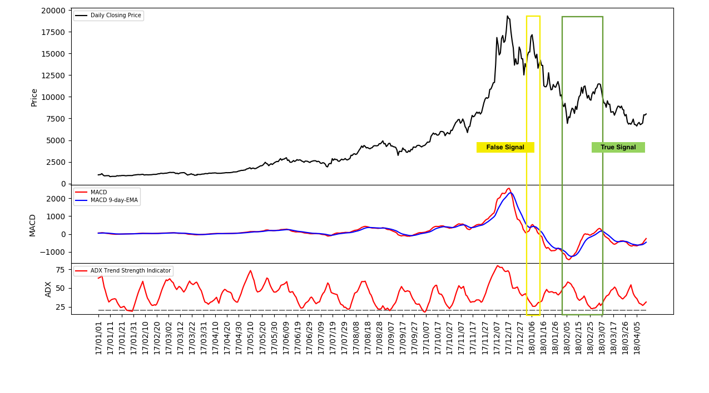
Notes:
Here we have an example. This is an application of EMA and ADX. But instead of using EMA of price, we’re using the EMA of another indicator, which is MACD. But the idea is similar, and we don’t explain it here. The red line is the short-term indicator, and the blue line is the long-term indicator.

Slide 23
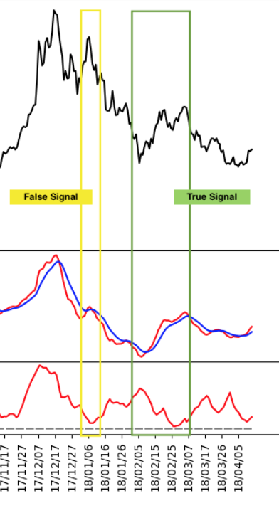
Notes:
Let’s look at it in detail
So let’s look at the yellow box here, the red line crosses above the blue line at this point. If we just use the SMA/EMA method we just talked about, this should be a buy signal. However, if we look at the ADX indicator here, it shows a relatively weak trend, which means this buy signal is a false signal. this is true because we can see that here the red line immediately crosses below the blue line, and the price of bitcoin also decreased.
Now we look at the green box. The red line crosses above the blue line at this point. The ADX indicator shows a relatively strong trend. And it is true that the red line stayed above the blue line for a while. There was also a significant increase in the bitcoin price. So this is the true signal.
So this example demonstrates that combining the SMA/EMA and ADX is a better way than using the SMA/EMA method alone. Thus, this is one way that we could use to improve our method.

Slide 24
Conclusion
1. Given the data from April 2017 to April 2018, under the optimized situation, the performance of Bollinger Bands exceeds that of SMA/EMA.
2. There is no universal standard setting (N or K) for these strategies, the parameters are market-sensitive.
Notes:
We have two discoveries in our project. Given the specific data and the optimized situation, the performance of Bolinger Bands exceeds that of SMA/EMA.
Second, there is no universal standard setting for these strategies, all the parameters are market-sensitive.
That’s all for our project.

Slide 25
Q&A
Notes:
Thank you so much for your time. And now we are open to questions

Slide 26
Thanks!

